Slide 1

Starting out with Python
Fifth Edition, Global Edition
Chapter 1
Introduction to Computers and Programming
Copyright © 2022 Pearson Education, Ltd. All Rights Reserved.

Slide 2
Topics
Introduction
Hardware and Software
How Computers Store Data
How a Program Works

Slide 3
Introduction
Computers can be programmed
Designed to do any job that a program tells them to
Program: set of instructions that a computer follows to perform a task
Commonly referred to as Software
Programmer: person who can design, create, and test computer programs
Also known as software developer

Slide 4
Hardware and Software
Hardware: The physical devices that make up a computer
Computer is a system composed of several components that all work together
Typical major components:
Central processing unit
Main memory
Secondary storage devices
Input and output devices

Slide 5
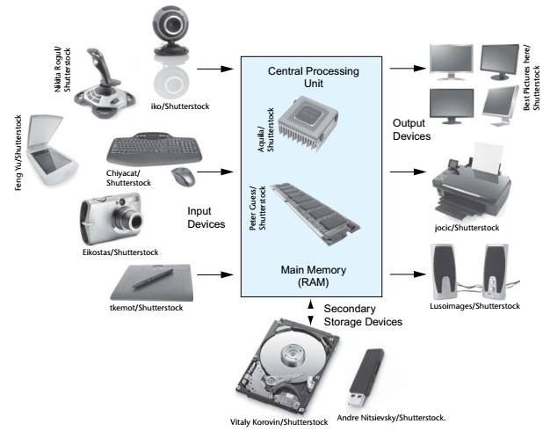
Hardware
Figure 1-2 Typical components of a computer system

Slide 6
The CPU
Central processing unit (CPU): the part of the computer that actually runs programs
Most important component
Without it, cannot run software
Used to be a huge device
Microprocessors: CPUs located on small chips

Slide 7
Main Memory
Main memory: where computer stores a program while program is running, and data used by the program
Known as Random Access Memory or RAM
CPU is able to quickly access data in RAM
Volatile memory used for temporary storage while program is running
Contents are erased when computer is off

Slide 8
Secondary Storage Devices
Secondary storage: can hold data for long periods of time
Programs normally stored here and loaded to main memory when needed
Types of secondary memory
Disk drive: magnetically encodes data onto a spinning circular disk
Solid state drive: faster than disk drive, no moving parts, stores data in solid state memory
Flash memory: portable, no physical disk

Slide 9
Input Devices
Input: data the computer collects from people and other devices
Input device: component that collects the data
Examples: keyboard, mouse, touchscreen, scanner, camera
Disk drives can be considered input devices because they load programs into the main memory

Slide 10
Output Devices
Output: data produced by the computer for other people or devices
Can be text, image, audio, or bit stream
Output device: formats and presents output
Examples: video display, printer
Disk drives and USB drives can be considered output devices because data is sent to them to be saved

Slide 11
Software (1 of 2)
Everything the computer does is controlled by software
General categories:
Application software
System software
Application software: programs that make computer useful for every day tasks
Examples: word processing, email, games, and Web browsers

Slide 12
Software (2 of 2)
System software: programs that control and manage basic operations of a computer
Operating system: controls operations of hardware components
Utility Program: performs specific task to enhance computer operation or safeguard data
Software development tools: used to create, modify, and test software programs

Slide 13
How Computers Store Data (1 of 2)
All data in a computer is stored in sequences of 0s and 1s
Byte: just enough memory to store letter or small number
Divided into eight bits
Bit: electrical component that can hold positive or negative charge, like on/off switch
The on/off pattern of bits in a byte represents data stored in the byte

Slide 14
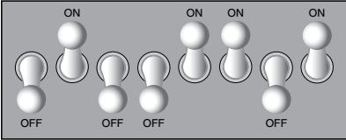
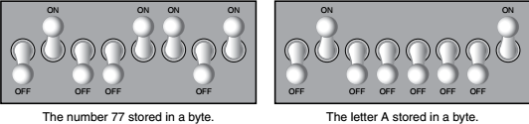
How Computers Store Data (2 of 2)
Figure 1-6 Think of a byte as eight switches
Figure 1-7 Bit patterns for the number 77 and the letter A

Slide 15
Storing Numbers (1 of 2)
Bit represents two values, 0 and 1
Computers use binary numbering system
Position of digit j is assigned the value 2^{j-1}
To determine value of binary number sum position values of the 1s
Byte size limits are 0 and 255
0 = all bits off; 255 = all bits on
To store larger number, use several bytes

Slide 16
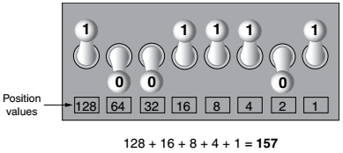
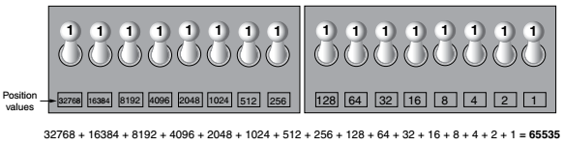
Storing Numbers (2 of 2)
Figure 1-11 The bit pattern for 157
Figure 1-12 Two bytes used for a large number

Slide 17
Storing Characters
Data stored in computer must be stored as binary number
Characters are converted to numeric code, numeric code stored in memory
Most important coding scheme is ASCII
ASCII is limited: defines codes for only 128 characters
Unicode coding scheme becoming standard
Compatible with ASCII
Can represent characters for other languages

Slide 18
Advanced Number Storage
To store negative numbers and real numbers, computers use binary numbering and encoding schemes
Negative numbers encoded using two’s complement
Real numbers encoded using floating-point notation

Slide 19
Other Types of Data
Digital: describes any device that stores data as binary numbers
Digital images are composed of pixels
To store images, each pixel is converted to a binary number representing the pixel’s color
Digital music is composed of sections called samples
To store music, each sample is converted to a binary number

Slide 20
How a Program Works (1 of 4)
CPU designed to perform simple operations on pieces of data
Examples: reading data, adding, subtracting, multiplying, and dividing numbers
Understands instructions written in machine language and included in its instruction set
Each brand of CPU has its own instruction set
To carry out meaningful calculation, CPU must perform many operations

Slide 21
How a Program Works (2 of 4)
Program must be copied from secondary memory to RAM each time CPU executes it
CPU executes program in cycle:
Fetch: read the next instruction from memory into CPU
Decode: CPU decodes fetched instruction to determine which operation to perform
Execute: perform the operation

Slide 22
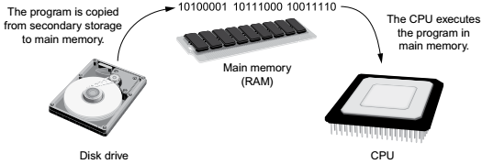
How a Program Works (3 of 4)
Figure 1-15 A program is copied into main memory and then executed

Slide 23
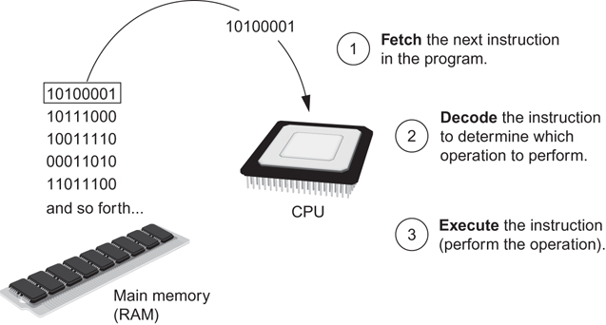
How a Program Works (4 of 4)
Figure 1-16 The fetch-decode-execute cycle

Slide 24
From Machine Language to Assembly Language (1 of 2)
Impractical for people to write in machine language
Assembly language: uses short words (mnemonics) for instructions instead of binary numbers
Easier for programmers to work with
Assembler: translates assembly language to machine language for execution by CPU

Slide 25
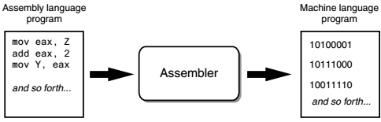
From Machine Language to Assembly Language (2 of 2)
Figure 1-17 An assembler translates an assembly language program to a machine language program

Slide 26
High-Level Languages (1 of 2)
Low-level language: close in nature to machine language
Example: assembly language
High-Level language: allows simple creation of powerful and complex programs
No need to know how CPU works or write large number of instructions
More intuitive to understand

Slide 27
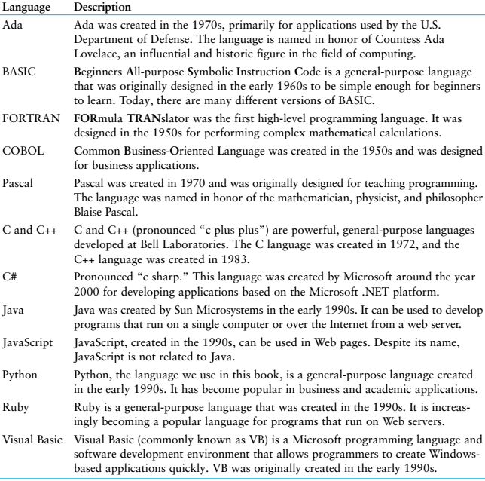
High-Level Languages (2 of 2)
Table 1-1 Programming languages

Slide 28
Keywords, Operators, and Syntax: an Overview (1 of 2)
Keywords: predefined words used to write program in high-level language
Each keyword has specific meaning
Operators: perform operations on data
Example: math operators to perform arithmetic
Syntax: set of rules to be followed when writing program
Statement: individual instruction used in high-level language

Slide 29
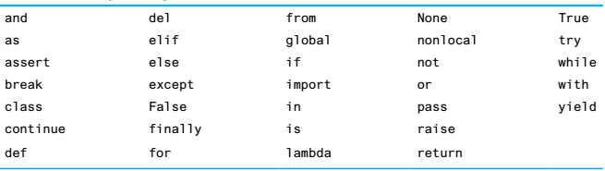
Keywords, Operators, and Syntax: an Overview (2 of 2)
Table 1-2 The Python key words

Slide 30
Compilers and Interpreters (1 of 4)
Programs written in high-level languages must be translated into machine language to be executed
Compiler: translates high-level language program into separate machine language program
Machine language program can be executed at any time

Slide 31
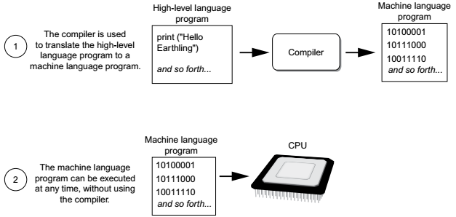
Compilers and Interpreters (2 of 4)
Figure 1-18 Compiling a high-level program and executing it

Slide 32
Compilers and Interpreters (3 of 4)
Interpreter: translates and executes instructions in high-level language program
Used by Python language
Interprets one instruction at a time
No separate machine language program
Source code: statements written by programmer
Syntax error: prevents code from being translated

Slide 33
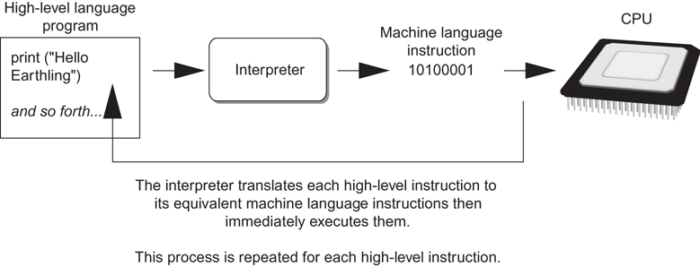
Compilers and Interpreters (4 of 4)
Figure 1-19 Executing a high-level program with an interpreter

Slide 34
Summary
This chapter covered:
Main hardware components of the computer
Types of software
How data is stored in a computer
Basic CPU operations and machine language
Fetch-decode-execute cycle
Complex languages and their translation to machine code
Installing Python and the Python interpreter modes

